Slide 1
Questions answers
Vladimir Dobrodeev

Slide 2
Q1.1: How many different apps contain the dataset?
There are 1543 different applications

Slide 3
Q1.2: What is the max and min data volume interval of the dataset?
Application 1988 has the largest data volume interval: [375, 11954282]
The following applications has the minimal interval (zero interval):
Application | Interval
939 | [717, 717]
1079 | [1194, 1194]
1080 | [1205, 1205]
1478 | [537, 537]
1586 | [53451, 53451]
1780 | [1444, 1444]
1810 | [1496, 1496]
1899 | [86440, 86440]

Slide 4
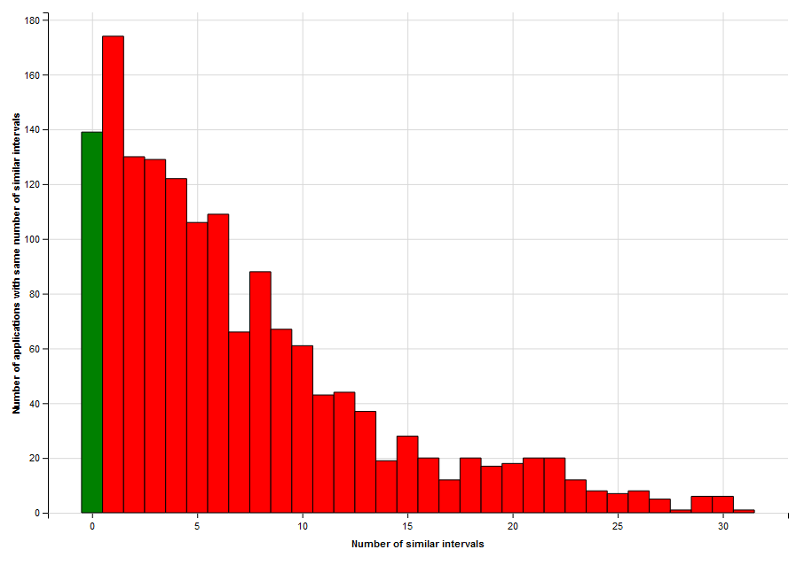
Q1.3: How many apps share similar data volume interval?
First approach:
Interval is similar, when minimum and maximum values of interval differ less, than by 10%
E.g. applications 12: [136, 720630] and 145: [136, 722586] are quite similar
The graphics shows, how many applications have same number of similar intervals
The answer is: 1404 applications share one or more similar intervals
E.g. 6 applications has 30 similar intervals

Slide 5
Q1.3
The second approach was to measure overlaps between application intervals
Applications 1: [136, 11903890] and 10: [204, 568323] has interval overlaps with all applications in the set
There is no applications, which intervals do not overlap

Slide 6
Q1.4: If two apps have similar data volume interval, how can you make them different during the analysis
The approach, that I tried was to take the maximal possible packet and change all traffic volumes in the following way:
traffic_volume = app_id * max_traffic_volume + traffic_volume
If we analyze this concrete set of data, this approach provides very good result width 99,999% accuracy
Most likely, this approach is not applicable for analyzing other sets of data

Slide 7
Q1.5: What is the max and min amount of samples for a particular app in the dataset?
For app 2 samples number is 1028845
For applications 939, 1079, 1080, 1478, 1586, 1780, 1810, 1899 there is only one sample

Slide 8
Q1.6: What is the min amount of samples needed for an app, such that it can be considered in the analysis?
This number was chosen in a way to provide the most accurate analysis with reasonable time
Finally it was chosen to use applications with 30 samples minimum
This number was selected to provide a good enough accuracy with larger percent of application involved in analysis

Slide 9
Q1.7: How many apps fulfil the previous requirement?
1387 applications fulfil this requirement

Slide 10
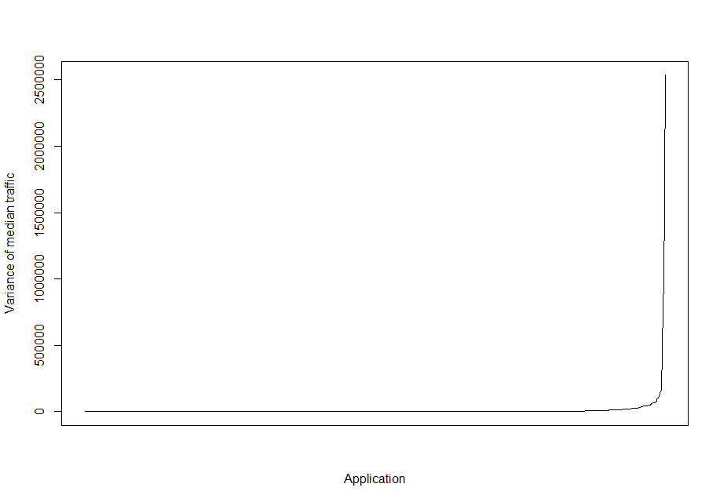
Q1.8: Is there any relation between app usage and location (base station)?
Yes, there is a relation for majority of application: 91,4% of applications show at least some difference in medians through different base station. For 88,4% this deviation is larger than minimal possible packet
However, for some applications difference in behavior is not significant
The chart, showing variance of median traffic volume per application:

Slide 11
Q1.8

Slide 12
Q1.9: How many different users has the dataset?
There are 998 users in dataset

Slide 13
Q1.10: Is there any relation between app usage, location (base station) and a particular?
Yes, it is
1410 application observe deviations for different users at different locations
However, same as in Q1.8 is applicable here

Slide 14
Q1.11: Is there any relation between app usage, location and time?
Yes, it is
1535 (all, except apps having 1 sample) observed some difference
However, same as in Q1.8 is applicable here

Slide 15
Comparison of analysis result with respect to different field combinations
Accuracy | Traffic volume | Base station | User | Time (as is) | Time (minute) | Time (hour)
45,4% | + | - | - | - | - | -
81,7% | + | + | - | - | - | -
86,4% | + | - | + | - | - | -
86,7% | + | + | + | - | - | -
88,3% | + | + | + | + | - | -
88% | + | + | + | - | + | -
87,2 | + | + | + | - | - | +
99,999% | + (if changed) | - | - | - | - | -

Slide 16
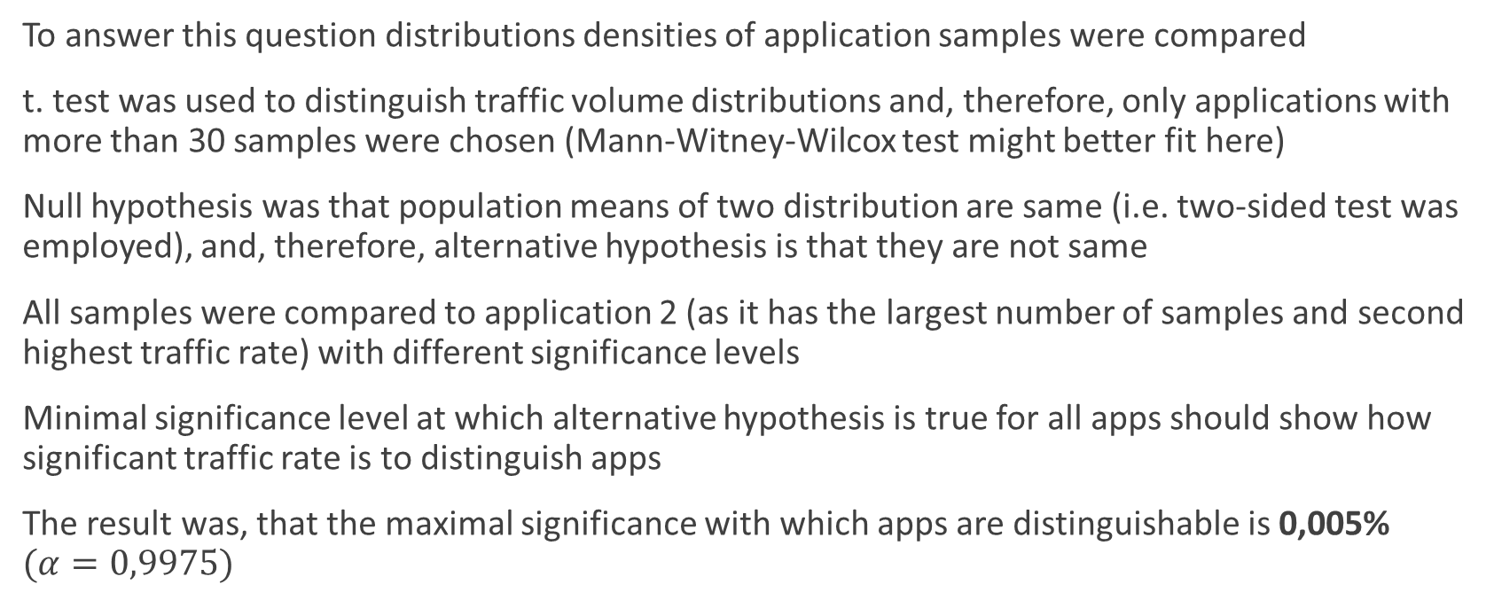
Q2.1: How significant is the data transferred rate of an app for distinguish it among the rest?
To answer this question distributions densities of application samples were compared
t. test was used to distinguish traffic volume distributions and, therefore, only applications with more than 30 samples were chosen (Mann-Witney-Wilcox test might better fit here)
Null hypothesis was that population means of two distribution are same (i.e. two-sided test was employed), and, therefore, alternative hypothesis is that they are not same
All samples were compared to application 2 (as it has the largest number of samples and second highest traffic rate) with different significance levels
Minimal significance level at which alternative hypothesis is true for all apps should show how significant traffic rate is to distinguish apps
The result was, that the maximal significance with which apps are distinguishable is 0,005% $(α=0,9975)$

Slide 17
Q2.2: Is it possible to categorize application usage based on data transferred rate?
An one approach might be to compare different applications behavior at different hours and put application with same behavior to the same category
As a behavior characteristic we might consider mean traffic; so categorization might look like “we are 95% confident that these two apps share same mean at given hour”
As an example 14:00 was taken as it has the largest number of samples
Categorization was done with 30 samples and 95% confidence
The answer is that it is possible to categorize applications with this criteria

Slide 18
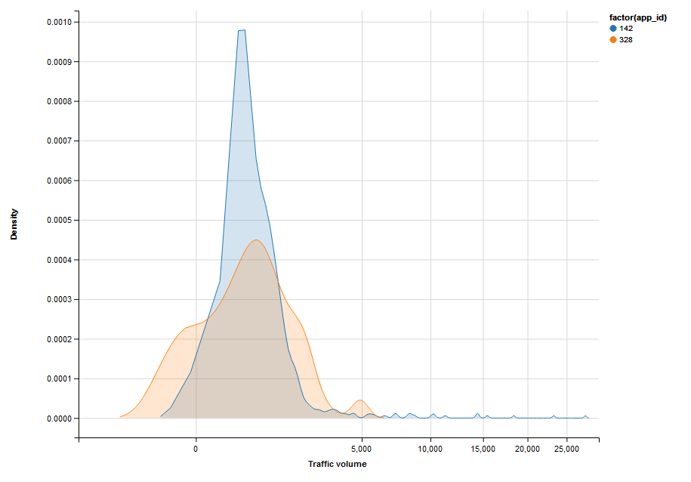
Q2.2
Example of category: applications 142 and 328

Slide 19
Q2.3: What is the minimal amount of samples to characterize data transferred rate?
Hour | Minimal number of samples | Number of characterized apps
0 | 2837 | 18
1 | 7589 | 3
2 | 2417 | 13
3 | 290 | 50
4 | 31 | 118
5 | 31 | 132
6 | 31 | 196
7 | 9646 | 6
8 | 1686 | 48
9 | 8637 | 21
10 | 4182 | 39
11 | 5378 | 34
12 | 10392 | 12
13 | 1320 | 95
14 | 3231 | 59
15 | 2625 | 54
16 | 1438 | 67
17 | 1968 | 55
18 | 13095 | 9
19 | 12781 | 7
20 | 1674 | 47
21 | 8814 | 10
22 | 1861 | 36
23 | 1941 | 25
Whole set | 18300 | 100
The following table presents minimal number of samples,
that allows to distinguish all given applications
Number of applications, which we can distinguish differs
from hour to hour

Slide 20
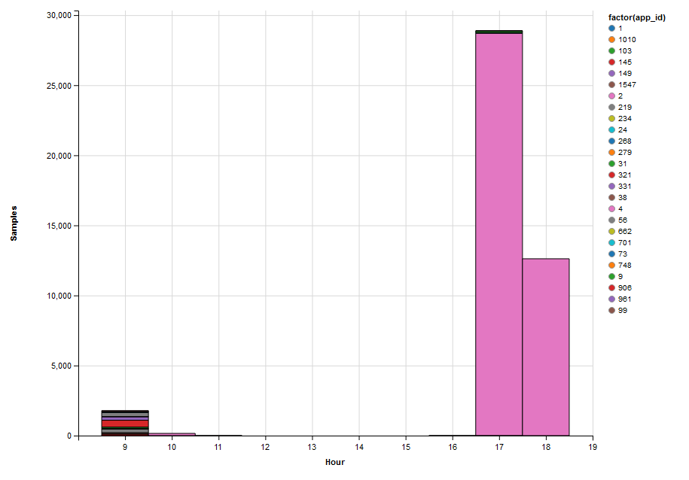
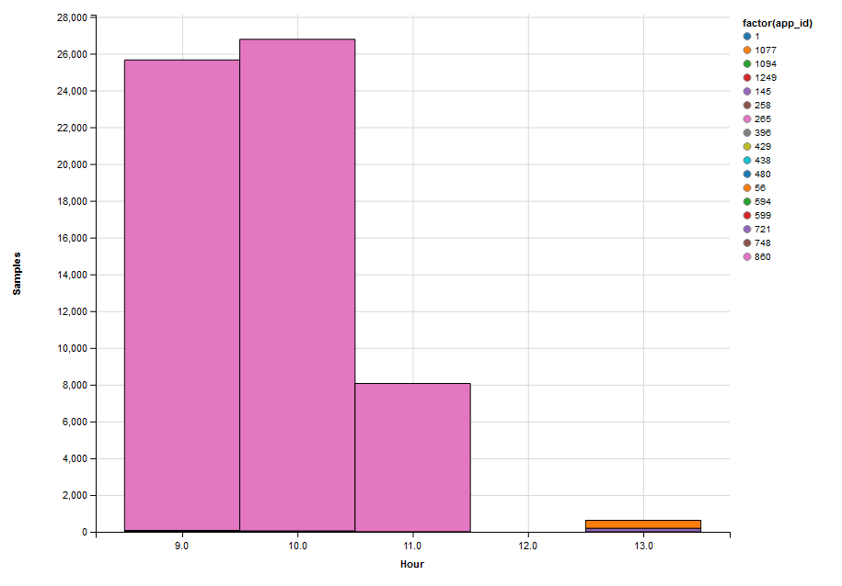
Q2.4: Are peak times of a base station influenced by a particular app?
Yes, for some base station we can observe peak hours, influenced by one application. Examples:

Slide 21
Q2.4
Example of base station, which has no obvious peak, caused by one application

Slide 22
Q2.5: Categorize users based on app usage
Users use different application and, therefore, they can not be categorized based on same app usage
However, we can compare user activity (total number of samples, for example) at different hours
Some users are active in the morning, i.e. they show most of samples between 6 and 10
Other categories: night users (from 0 to 6), day users (from 10 to 18, working day is implied) and evening users (from 18 to 0)

Slide 23
Q2.6: Is it possible to identify users’ mobility (trajectory) based on base station access
Yes, it is possible
906 (90,8%) of users are trackable (i.e. they visited more than one base station)
However, building an actual trajectory is not a correct task as:
1) times we observe show just when sample was captured;
2) if time is large it might not show the fact, that stations are distant from each other;
2) zero or relatively small interval, however, indicate neighbor base stations

Slide 24
Q2.6
Examples: users 0095346 and 0057202
From | To | Time | Start | Finish
186327 | 207059 | 2 | 21101936 | 21101938
207059 | 186327 | 75 | 21102925 | 21103000
186327 | 207059 | 128 | 21104920 | 21105048
207059 | 140370 | 5 | 21110007 | 21110012
140370 | 186327 | 4 | 21111009 | 21111013
186327 | 140370 | 1 | 21111046 | 21111047
140370 | 186327 | 4 | 21111047 | 21111051
186327 | 207059 | 20118 | 21113031 | 21133149
207059 | 176396 | 8 | 21134108 | 21134116
176396 | 206352 | 6 | 21135109 | 21135115
206352 | 176396 | 0 | 21135115 | 21135123
176396 | 206352 | 1 | 21135123 | 21135124
206352 | 176396 | 0 | 21135124 | 21135124
176396 | 206352 | 1 | 21135124 | 21135125
206352 | 186327 | 69 | 21141049 | 21141118
186327 | 157144 | 6 | 21142109 | 21142115
157144 | 137643 | 112 | 21143014 | 21143126
137643 | 157144 | 0 | 21143126 | 21143133
157144 | 137643 | 1 | 21143133 | 21143134
137643 | 157144 | 0 | 21143134 | 21143134
157144 | 137643 | 4 | 21143134 | 21143138
137643 | 215255 | 5 | 21144109 | 21144114
215255 | 137643 | 2475 | 21152326 | 21154801
137643 | 215255 | 5673 | 21155328 | 21161001
215255 | 186327 | 4503 | 21161002 | 21165505
186327 | 207059 | 1399 | 21170045 | 21171444
207059 | 186327 | 782 | 21172043 | 21172825
186327 | 207059 | 7630 | 21184409 | 21192039
From | To | Time | Start | Finish
283213 | 283212 | 0 | 21080036 | 21124902
283212 | 283213 | 2 | 21124902 | 21124904
283213 | 283212 | 1 | 21124921 | 21124922
283212 | 283213 | 0 | 21124922 | 21125008
283213 | 283212 | 3 | 21125008 | 21125011
283212 | 283213 | 2 | 21125011 | 21125013
283213 | 283212 | 2 | 21125013 | 21125015
283212 | 283213 | 0 | 21125015 | 21125015
283213 | 283212 | 1 | 21125015 | 21125016
283212 | 283213 | 1 | 21130942 | 21130943
283213 | 283212 | 1 | 21130951 | 21130952
283212 | 283213 | 6 | 21131000 | 21131006
283213 | 283212 | 0 | 21131006 | 21131006
283212 | 283213 | 5 | 21131006 | 21131011
283213 | 283212 | 2 | 21131011 | 21131013
283212 | 283213 | 20 | 21131013 | 21131033
283213 | 283212 | 70 | 21131944 | 21132014
283212 | 283213 | 362 | 21132955 | 21133317
283213 | 283212 | 10 | 21150011 | 21150021
283212 | 283213 | 8 | 21150021 | 21150029
283213 | 283212 | 3 | 21150029 | 21150032
283212 | 283213 | 1 | 21152022 | 21152023

Slide 25
Q3.1: Pipeline
Prepare data
Filter out application not fulfilling requirement
Change time according selected granularity
Make train and test sets from initial data set
Data reading
Make model, based on data
Compare labels obtained by training and actual labels
Perform KNN
Extract labels from train
Extract selected fields from train and test

Slide 26
Q3.2: Most interesting findings
The most interesting things were:
1) applications making base station peak times: sometimes just one user might cause this peak;
2) large similarity, which different applications showed (same purpose applications?); however density is not exactly the same but it is difficult to distinguish it numerically
3) most likely there is, in fact, not enough data to properly characterize application

Slide 27
Q3.3: Most important findings
1) Traffic volume for different applications observed similarity and it only can not be used to distinguish applications
2) Information of user, time and location allows much better identify application; for this set time can be used with second preciseness; it is also important that at different hour behavior differs
3) The way to identify application is a construction of usage pattern for a given user this pattern can be built considering time and location; data for week might be very helpful

